Slide 1
GITHub Essentials
The basics of GITHub
Notes:
Add instructor notes here.

Slide 2
Overview of GIT
Notes:
Add instructor notes here.

Slide 3
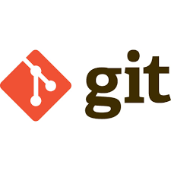
Overview
Git is a distributed revision control and source code management (SCM) system
Emphasis on speed, data integrity and support for distributed, non-linear workflows.
Every Git working directory is a full-fledged repository with complete history and full version-tracking capabilities, independent of network access or a central server.
Like the Linux kernel, Git is free software distributed under the terms of the GNU General Public License version 2.
Notes:
Git was initially designed and developed by Linus Torvalds for Linux kernel development in 2005, and has since become the most widely adopted version control system for software development.
Add instructor notes here.

Slide 4
Design Base
Git's design was inspired by BitKeeper and Monotone.
Git was originally designed as a low-level version control system engine on top of which others could write front ends, such as Cogito .
The core Git project has since become a complete version control system that is usable directly.
While strongly influenced by BitKeeper, Torvalds deliberately attempted to avoid conventional approaches, leading to a unique design.
Notes:
BitKeeper is a software tool for distributed revision control (configuration management,SCM, etc.) of computer source code
Monotone is an open source software tool for distributed revision control.
Cogito (originally git-pasky) is a revision control system layered on top of Git. It is historically the first Git frontend, which appeared in April 2005, just days after Git itself. While Git was initially meant just as the low-level interface, Cogito started with the stated goal of becoming a user-friendly front-end.
Add instructor notes here.

Slide 5
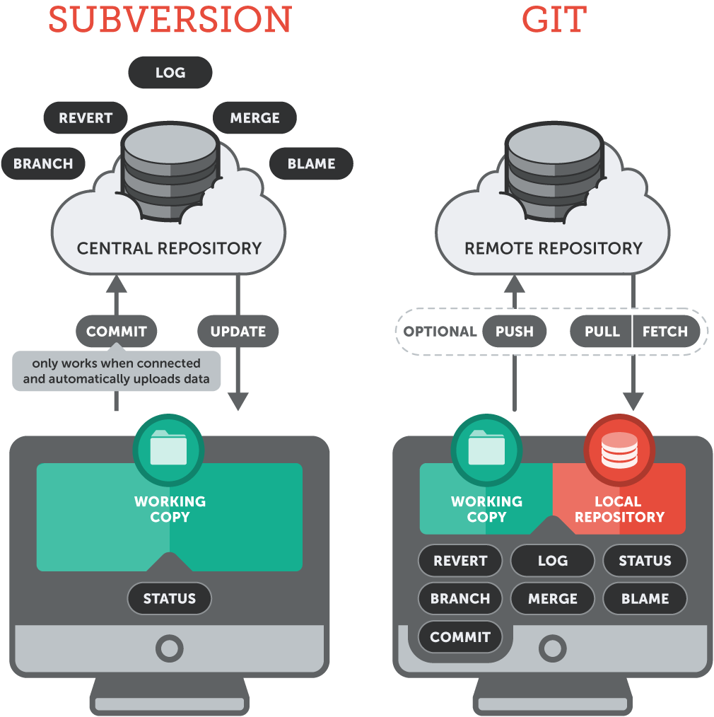
CVC vs DVC

Slide 6
Characteristics
Strong support for non-linear development
Distributed development
Compatibility with existing systems/protocols
Efficient handling of large projects
Cryptographic authentication of history
Toolkit-based design
Pluggable merge strategies
Garbage accumulates unless collected
Periodic explicit object packing
Notes:
Add instructor notes here.

Slide 7
GIT server
Gitolite
Gitolite is an access control layer on top of git, providing fine access control to git repositories. It relies on other software to remotely view the repositories on the server.
Gerrit
Gerrit provides two out of three functionalities: access control, and managing repositories. It uses jGit. To view repositories it is combined e.g. with Gitiles or GitBlit.
Gitblit
Gitblit can provide all three functions, but is in larger installations used as repository browser installed with gerrit for access control and management of repositories.
Gitiles
Gitiles is a simple repository browser, usually used together with gerrit.
Bonobo Git Server
Bonobo Git Server is a simple git server for Windows implemented as an ASP.NET gateway.It relies on the authentication mechanisms provided by Windows Internet Information Services, thus it does not support SSH access but can be easily integrated with Active Directory.
Commercial solutions
Commercial solutions are also available to be installed on premises, amongst them GitHub Software (using native git, available as a vm),Stash (using jGit), Team Foundation Server (using libgit2).
Notes:
Add instructor notes here.

Slide 8
Basics GIT commands
Notes:
Add instructor notes here.

Slide 9
Basic Terms
Non Bare Repository
A bare repository in Git is a normal repository which can be used to version control files by executing git commit commands
This repository is initialized with a .git folder
Bare Repository
A central repository can be created as non bare repository and multiple developers are working on this repository and pushing their changes (won’t be allowed but assume).
There will not be a git commit in this repository
Branch
Branch is essentially an independent line of development that enables you to isolate your work from others.
Notes:
Git was initially designed and developed by Linus Torvalds for Linux kernel development in 2005, and has since become the most widely adopted version control system for software development.
Add instructor notes here.

Slide 10
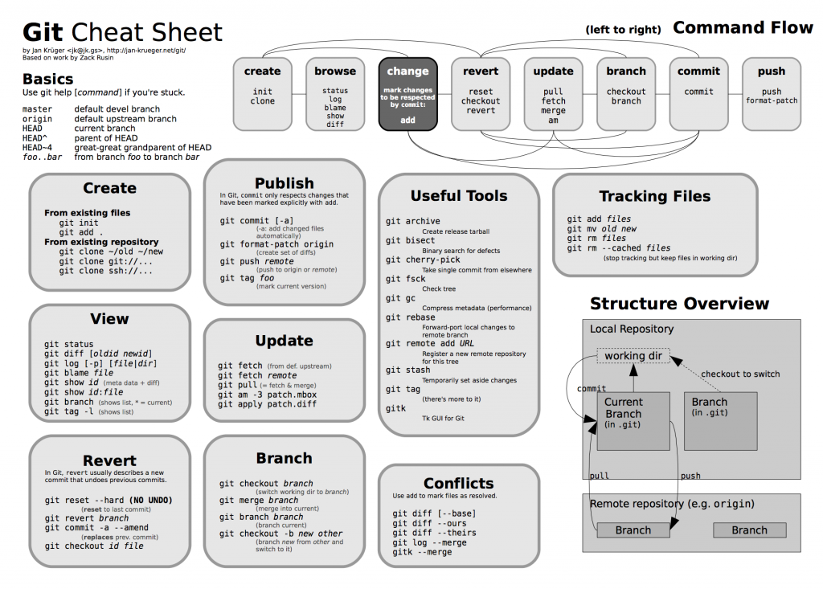
Characteristics
Notes:
Add instructor notes here.

Slide 11
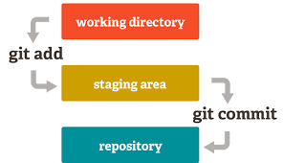

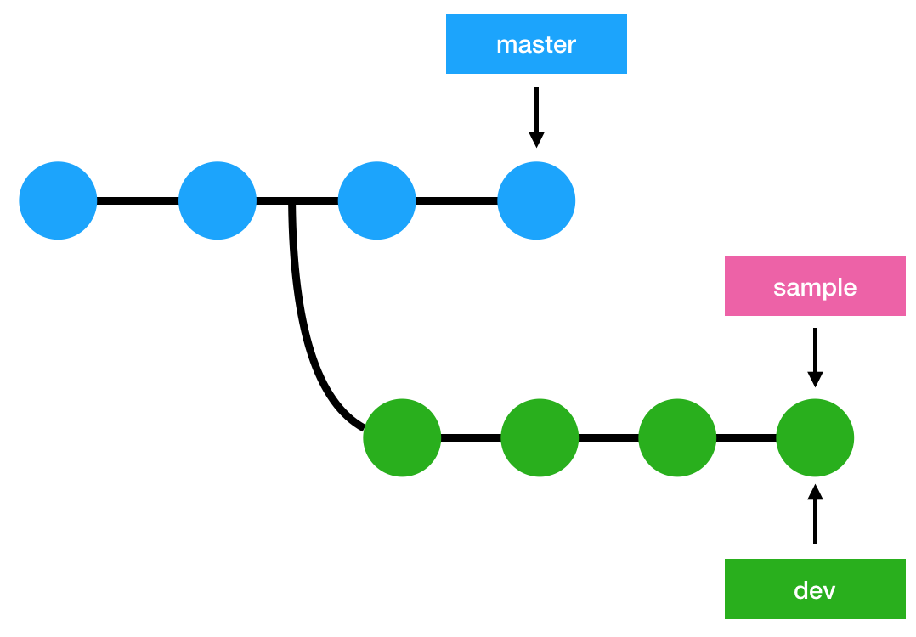

Basic GIT Commands
git commit
git init
Folder
repository
git clone
Repository1
git branch
New repository
git checkout
Notes:
Add instructor notes here.

Slide 12
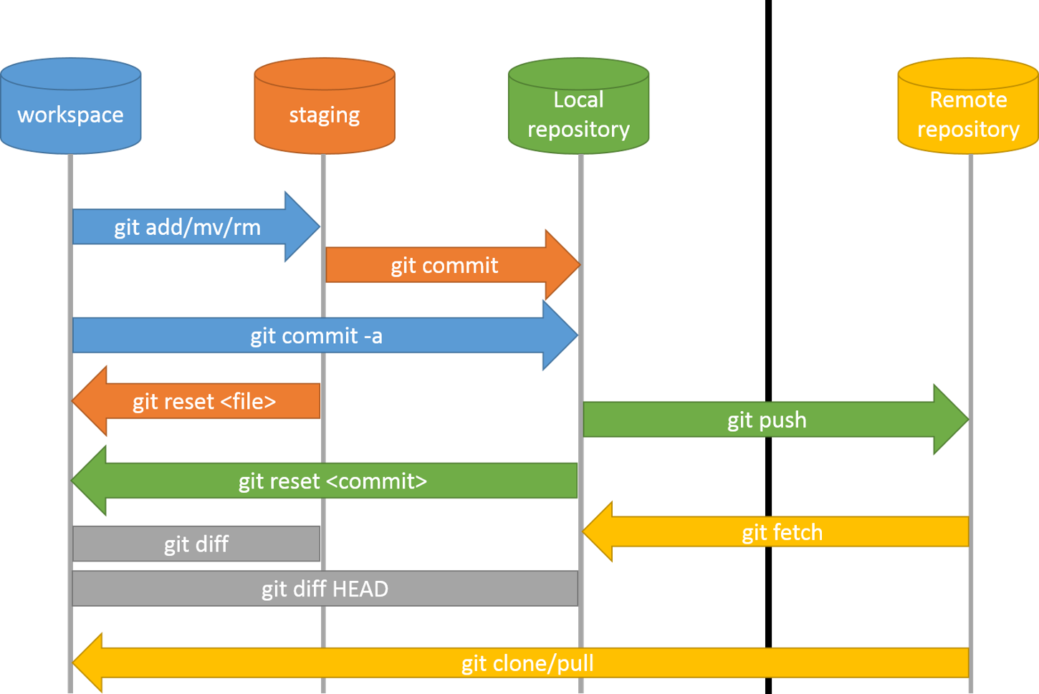
Basic GIT Commands
git push
git pull
Notes:
Add instructor notes here.

Slide 13

Demo on GIT commands
Notes:
Add the notes here.
Add instructor notes here.

Slide 14

Introduction to GitHub
Notes:
Add instructor notes here.

Slide 15

GitHub Introduction
GitHub is a web-based hosting service for version control using git.
It is mostly used for computer code. It offers all of the distributed version control and source code management(SCM) functionality of Git as well as adding its own features.
It provides access control and several collaboration features such as bug tracking, feature requests, task management, and wikis for every project.
GitHub offers plans for both private repositories and free accounts which are commonly used to host open-source software projects

Slide 16
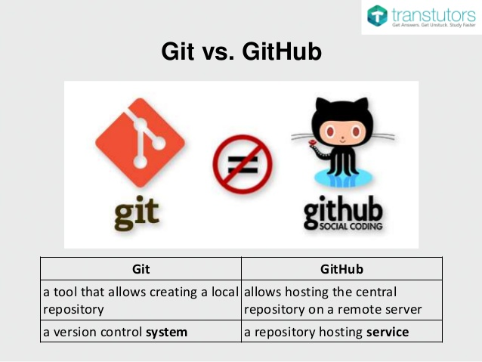
Git Vs GitHub

Slide 17
GitHub Features
git hosting provider server
easy contributions of code between our project members
collaboration features
read me, wiki
pull requests
commit history
access control to various collaborators.
issue tracking
feature to compare two branches or two commits
Easy to use Web Based Graphical interface

Slide 18
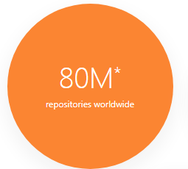
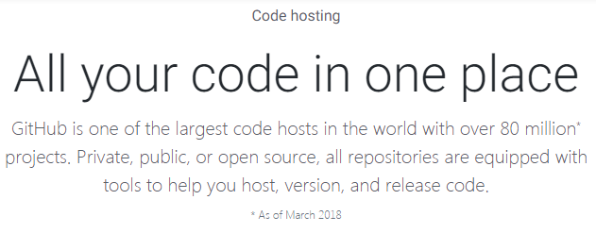
GitHub Hosting Server
GitHub provides unlimited public and private repositories
Users can created Repositories and store code
Commit, Branching and Pull within repositories
Local repositories can be pushed to remote repositories

Slide 19
GitHub Hosting Server
GitHub Repositories
Users can create Repositories in GitHub
Repositories are classified based on Access as
Public repositories
Credentials are required to create and store code in Public repositories
Any one can download the content in a public repository
Private repositories
These are available only for a paid account
Access to the content of the repository is controlled by the creator of the repository

Slide 20
GitHub Hosting Server
GitHub Repositories
Repositories are classified based on functionality as
Git repositories
Similar to creating repositories with git init
Commits can happen in these repositories
Git bare repositories
These are central repositories
Commit cannot be done on a bare repository
They are targets of git push and they act as a central place to store code from multiple developers

Slide 21
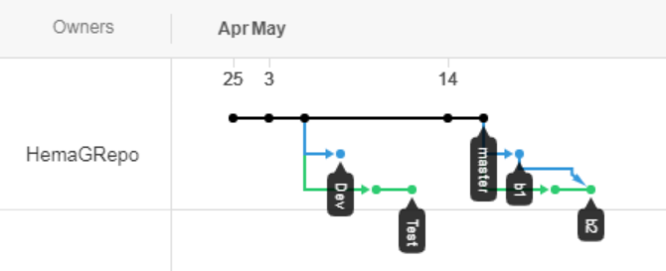
GitHub Hosting Server
GitHub Branches
A git repository has a master branch on which all comments happen
New Branches can be created and commits can happen in different branches
GitHub provides a branch history to view the HEAD of each commit

Slide 22


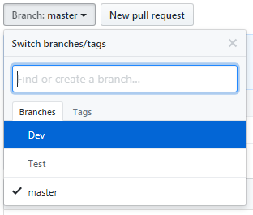
Demo
Creating Repositories in GitHub
Creating Branches in Repositories in GitHub

Slide 23
GitHub Hosting Server
GitHub Pull and Merge
Git hub provides options to submit pull requests
Pull requests let you tell others about changes you've pushed to a repository on GitHub.
Once a pull request is opened, once can review the potential changes before the changes are merged into the repository.
Merge can be done on a pull request into the upstream branch when work is completed.
Anyone with push access to the repository can complete the merge.
If the changes in a topic branch need not be merged to the upstream branch, the pull request can be closed without merging.

Slide 24
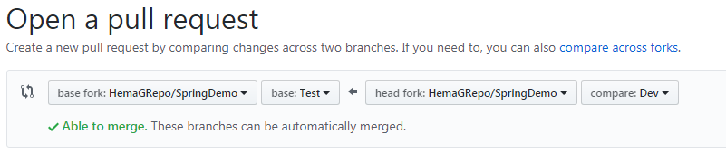
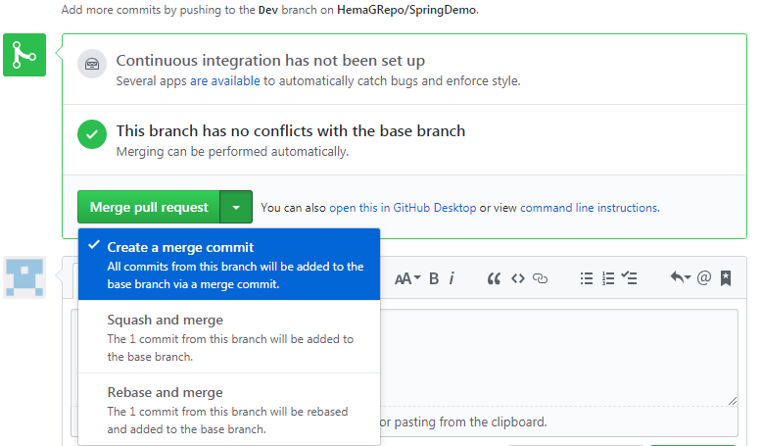
Demo
Pull request for branches in GitHub

Slide 25
Issue Tracking in GitHub
Issue Tracking
Github provides options for Code review and issue tracking
Initially an issue will be open state and the Issue tracking tab provides options for the following:
Deal with your issues just like you deal with email
Create and apply labels to issues to assign to users or categorize
Drag and drop issues to prioritize them
Search, sort, and filter
Close issues from commit messages
An issue can be automatically closed when a commit references an issue number

Slide 26
GITHub desktop
Notes:
Add instructor notes here.

Slide 27
GitHub Desktop
What is GitHub Desktop
GitHub Desktop (formerly GitHub for Windows) is a more streamlined GUI.
Uses PowerShell for git command line.
The version of git it includes lags the latest release.
"Before you set up GitHub Desktop, you must already have a GitHub or GitHub Enterprise account."
You log in with your account, your GitHub repositories are automatically detected.

Slide 28
GitHub Desktop
Installing GitHub Desktop
You can install GitHub Desktop on Microsoft Windows 7 or later .
Visit the GitHub Desktop download page.
Choose Download for Windows.
In your computer's Downloads folder, double-click GitHub Desktop.
In the pop-up window, click Install.
After the program has been installed, click Run.
Add your GitHub.com or GitHub Enterprise account information to GitHub Desktop so you can access your repositories.

Slide 29
GitHub Desktop
Creating Repositories
GitHub Desktop provides 3 options for creating repositories
Creating New Repositories
Add a local repository
Creating New Repositories
New Git repositories can be created using the Create New Repository Option
All Git commands can be executed in the repository created

Slide 30
GitHub Desktop
Adding a Local repository
GitHub Desktop provides a GUI to monitor a local GIT repository
Repository Explorer and Status view are available
Changes to a local repository can be monitored and commits can be issued.
Branching is also possible in GitHub desktop
The branches can be pushed to the linked GitHub repository
Automatically in remote repository the commit happens on the same branch
Automatic detection of changes in the content of the repository

Slide 31
Demo on GITHub Desktop
Notes:
Add the notes here.
Add instructor notes here.

